Slide 1
The Gist Strategy
Generating Interactions Between Schemata & Text

Slide 2
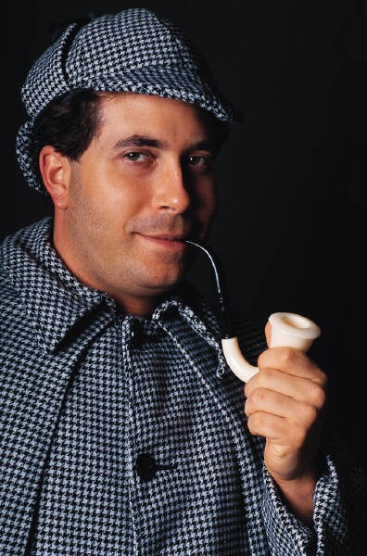
The GIST Strategy (Generating Interactions Between Schemata & Text)
Read the first & second sentences of a paragraph
Retell the sentences in 10 or fewer words
Continue with the same procedure for the rest of the paragraph
Summarize the entire paragraph

Slide 3
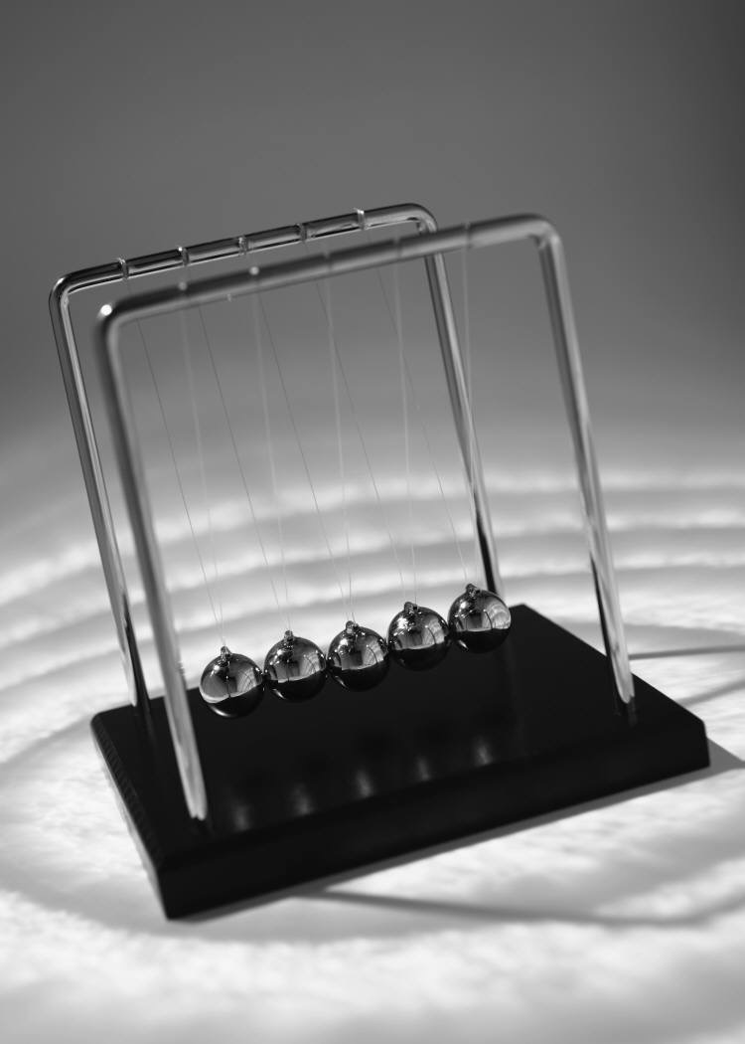
Newton’s Law’s
Isaac Newton, a 17th century scientist, put forth three laws which explain why objects move (or don’t move) as they do. These three laws have become known as Newton’s laws of motion. While most people know what Newton’s laws say, many people do not know what they mean (or simply do not believe what they mean).
Notes:
Retelling is an powerful strategy. We do it everyday. Think of the latest movie you have seen. I am certain that you could summarize it in less than the two hours it took to watch it. I do this movie retelling strategy with my students. I pair them and have each of them retell the last movie they saw to each other. Then we move to paragraphs. If you have an index card, you will use it to combine and retell the first two sentences of this paragraph. Write your new sentence on the index card. Retell the third sentence in your own words.
Write it on the index card. Now combine the two original sentences into one original sentence.
Read the first & second sentences of a paragraph
Retell the sentences in 10 or fewer words
Continue with the same procedure for the rest of the paragraph
Summarize the entire paragraph
You could put your students into pairs and have them do this activity.

Slide 4
Newton’s Law’s
Isaac Newton, a 17th century scientist, put forth three laws which explain why objects move (or don’t move) as they do. These three laws have become known as Newton’s laws of motion. While most people know what Newton’s laws say, many people do not know what they mean (or simply do not believe what they mean).

Slide 5
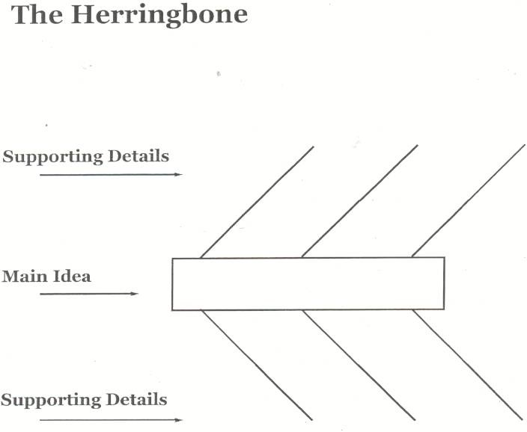
The Herringbone
Actual Sentence s
Combined Sentences
Notes:
Start with an organizer to focus the sentences.

Slide 6
The Herringbone
Isaac Newton, a 17th century scientist, put forth 3 laws which explain object movement.
While
Most
People
Know what
Newton’s Laws say, many do not know meaning.
Actual Sentences
These 3
laws have
become
known as
Newton’s
Laws of
Motion.
Actual Sentence s
Isaac Newton’s 3 Laws of Motion, which are confusing to most people, explain the movement of objects.
Summary
Isaac Newton’s Laws of Motion explain object movement.
People don’t understand Newton’s Laws.
Combined Sentences
Combined Sentences
Notes:
This organizer shows how the actual sentences are combined to create the summary.

Slide 7
The Herringbone
Isaac Newton, a 17th century scientist, put forth 3 laws which explain object movement.
While
Most
People
Know what
Newton’s Laws say, many do not know meaning.
Actual Sentences
These 3
laws have
become
known as
Newton’s
Laws of
Motion.
Actual Sentence s
Summary
Isaac Newton’s 3 Laws of Motion, which are confusing to most people, explain the movement of objects.
Isaac Newton’s Laws of Motion explain object movement.
People don’t understand Newton’s Laws.
Combined Sentences
Combined Sentences
Notes:
The circles and arrows show how the ideas are connected to allow the summary to emerge.

Slide 8
Annotating—An Example
 | Isaac Newton, a 17th century scientist put forth three laws which explain why objects move (or don’t move) as they do. These three laws have become known as Newton’s laws of motion. While most people know what Newton’s laws say, many people do not know what they mean (or simply do not believe what they mean).
Isaac Newton
3 laws
Explain
Movement of objects
Laws of motion
Confusing
Newton’s three laws of motion which are confusing to some people explain how objects move.
Notes:
Annotating is a powerful strategy because it helps the brain to organize information. Help the students to identify the topic and focus of the topic and put them on post it notes. The post it notes serve as a table of contents to organize and connect the new information to the previously learned information. The summary grows out of the two post it notes.

Slide 9
Newton’s first law of motion is often stated as the law of inertia. It says that an object at rest tends to stay at rest and an object in motion tends to stay in motion with the same speed and in the same direction unless acted upon by an unbalanced force. There are two parts to this statement — one which predicts the behavior of stationary objects and the other which predicts the behavior of moving objects. The behavior of all objects can be described by saying that objects tend to “keep on doing what they’re doing” unless acted upon by an unbalanced force. This means that all objects resist changes in their state of motion.
Newton’s Law of Inertia
Notes:
Using whatever strategy you find works best for you, find the topic and write it on a post it note and underneath the topic, write what the author wants you to know about the topic. Then grab an index card and write the main idea on it. Remember to start with a capital letter and end with a period.

Slide 10
Newton’s first law of motion is often stated as the law of inertia. It says that an object at rest tends to stay at rest and an object in motion tends to stay in motion with the same speed and in the same direction unless acted upon by an unbalanced force. There are two parts to this statement — one which predicts the behavior of stationary objects and the other which predicts the behavior of moving objects. The behavior of all objects can be described by saying that objects tend to “keep on doing what they’re doing” unless acted upon by an unbalanced force. This means that all objects resist changes in their state of motion.
Newton’s Law of Inertia
Notes:
You should have a copy of this paragraph. Analyze it for the topic and the controlling idea. Ask the question what does the author want you the reader to know about the topic?

Slide 11
Newton’s first law of motion is often stated as the law of inertia. It says that an object at rest tends to stay at rest and an object in motion tends to stay in motion with the same speed and in the same direction unless acted upon by an unbalanced force. There are two parts to this statement — one which predicts the behavior of stationary objects and the other which predicts the behavior of moving objects. The behavior of all objects can be described by saying that objects tend to “keep on doing what they’re doing” unless acted upon by an unbalanced force. This means that all objects resist changes in their state of motion.
Newton’s Law of Inertia
Newton’s Law of Inertia
Predicts behavior of moving objects and those at rest
Unless acted upon by an
Unbalanced force
Newton’s first law, the Law of Inertia, predicts behavior of still and moving objects when acted upon by an unbalanced force.
Notes:
Analyze the paragraph for the topic and the controlling idea. Write the topic on a post it note. Think about what the author wants the reader to know about the topic? Write this information below the topic. That is called the controlling idea.

Slide 12
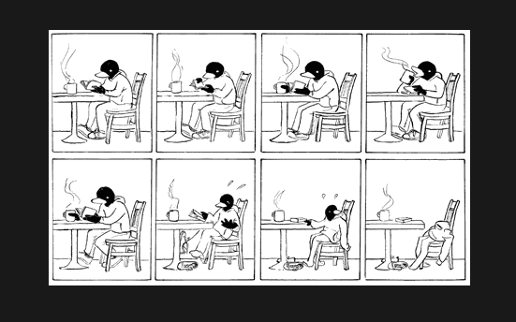
The Shrinking Paragraph and Other Strategies

Slide 13
The Shrinking Paragraph and Other Strategies

Slide 14
The Paragraph Shrinking Activity
Learning to identify and state the main idea:
Name the who or what (the main person, animal, place, or thing the passage is about)
Tell the most important thing about who or what
Write the main idea in 10 words or less

Slide 15
First, the plane’s engine caught on fire and continued to burn. When Amelia Earhart flew to a higher altitude trying to put out the fire, ice began to build up on the plane’s wings. From start to finish, Amelia Earhart’s first solo transatlantic flight was filled with near disasters. The weight of the ice on the plane’s wings finally forced her to come down. Because the clouds were so low and thick during her descent, she almost crashed in the ocean. By the time Amelia finally spotted the coast of Ireland, she was so far off course that her plane was nearly out of fuel.
Notes:
Analyze (break apart) the paragraph for the important ideas.

Slide 16
First, the plane’s engine caught on fire and continued to burn. When Amelia Earhart flew to a higher altitude trying to put out the fire, ice began to build up on the plane’s wings. From start to finish, Amelia Earhart’s first solo transatlantic flight was filled with near disasters. The weight of the ice on the plane’s wings finally forced her to come down. Because the clouds were so low and thick during her descent, she almost crashed in the ocean. By the time Amelia finally spotted the coast of Ireland, she was so far off course that her plane was nearly out of fuel.
WHO: Amelia Earhart HOW: filled with near disasters
WHERE: in an airplane
WHAT @ HER? First solo transatlantic flight
WHEN: from start to finish
WHY:
Notes:
After the analysis, answer the who, what, where, when, why, how questions.

Slide 17
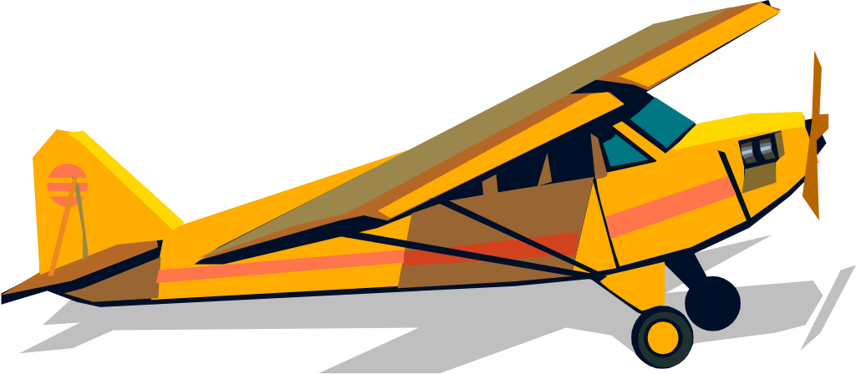
Put it all together
Who?
What about her?
Stated Main Idea: Amelia Earhart’s first solo transatlantic flight was filled with near disasters.
How?
Notes:
Combine the information into a summary.

Slide 18
Topic/Question/Answer Model
Topic: Amelia Earhart’s first solo transatlantic flight
Question: What about it?
Answer: filled with near disasters
Summary: Amelia Earhart’s first solo transatlantic flight was filled with near disasters.
Notes:
Identify the topic and decide what the author wants the reader to know about the topic. The summary should emerge when these are combined.

Slide 19
READ
Read the paragraph to get an idea of what it is about (Topic)
Look for important words that are repeated
Evaluate each sentence and highlight, underline, or circle the important words
Write the words you underlined/circled for each sentence
Analyze the words you underlined to determine what they have in common
Decide upon the main idea

Slide 20
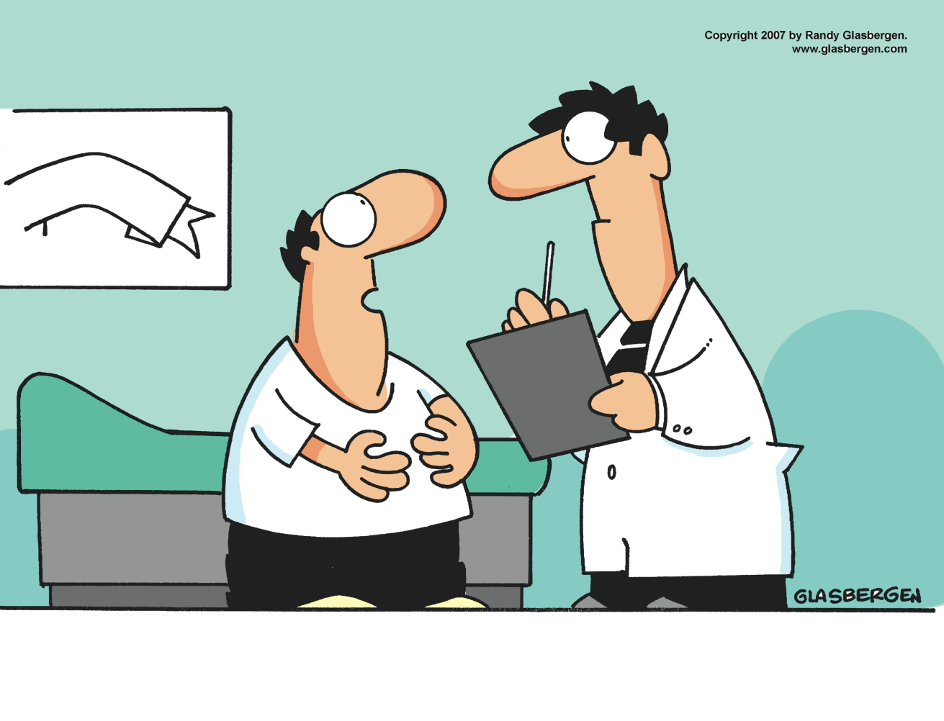
WHAT ARE SUPPORTING DETAILS?
“I know why I don’t lose weight. Eating big meals and lots of snacks makes me happy. Drinking beer makes me happy. Not exercising makes me happy.”

Slide 21
WHAT ARE SUPPORTING DETAILS?
“I know why I don’t lose weight. Eating big meals and lots of snacks makes me happy. Drinking beer makes me happy. Not exercising makes me happy.”
Summary:
The man can’t lose weight because he enjoys the things that make him gain weight.

Slide 22
First-degree burns are burns that leave a painful red mark but do not break the skin, and thus they do not often become infected. Burns that are classified as second-degree burns are often extremely painful, and, since the skin has been broken, they may become infected. In a third-degree burn, both the outer layer and lower layer of skin are burned. There may be little pain because nerve endings have been destroyed. Because so much of the skin’s protection has been lost, the possibility of serious, even fatal infection is great with a third-degree burn.
Notes:
Analyze the paragraph for the key ideas.

Slide 23
First-degree burns are burns that leave a painful red mark but do not break the skin, and thus they do not often become infected. Burns that are classified as second-degree burns are often extremely painful, and, since the skin has been broken, they may become infected. In a third-degree burn, both the outer layer and lower layer of skin are burned. There may be little pain because nerve endings have been destroyed. Because so much of the skin’s protection has been lost, the possibility of serious, even fatal infection is great with a third-degree burn.
Notes:
These are the ideas that are necessary to build summary.

Slide 24
First-degree burns are burns that leave a painful red mark but do not break the skin, and thus they do not often become infected. Burns that are classified as second-degree burns are often extremely painful, and, since the skin has been broken, they may become infected. In a third-degree burn, both the outer layer and lower layer of skin are burned. There may be little pain because nerve endings have been destroyed. Because so much of the skin’s protection has been lost, the possibility of serious, even fatal infection is great with a third-degree burn.
Summary:
Burn injuries are classified in three categories, according to their severity.
Notes:
The arrows show the connections to the summary.

Slide 25
